Slide 1
MODERN OPERATING SYSTEMS Third Edition ANDREW S. TANENBAUM Chapter 8 Multiple Processor Systems

Slide 2
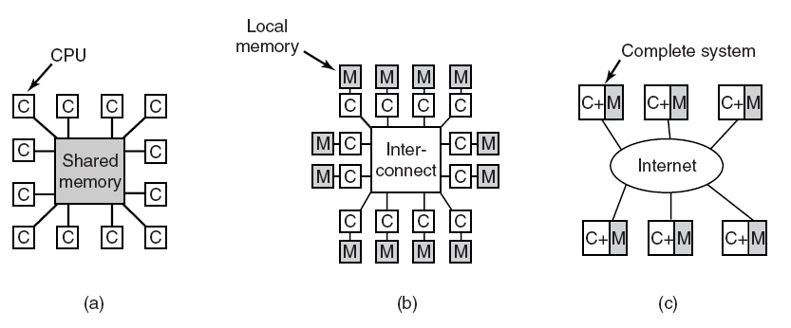
Multiple Processor Systems
Figure 8-1. (a) A shared-memory multiprocessor. (b) A message-passing multicomputer. (c) A wide area distributed system.

Slide 3
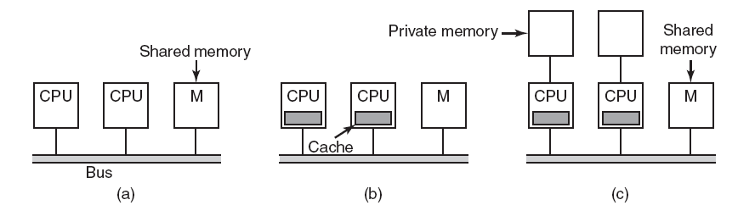
UMA Multiprocessors with Bus-Based Architectures
Figure 8-2. Three bus-based multiprocessors. (a) Without caching. (b) With caching. (c) With caching and private memories.

Slide 4
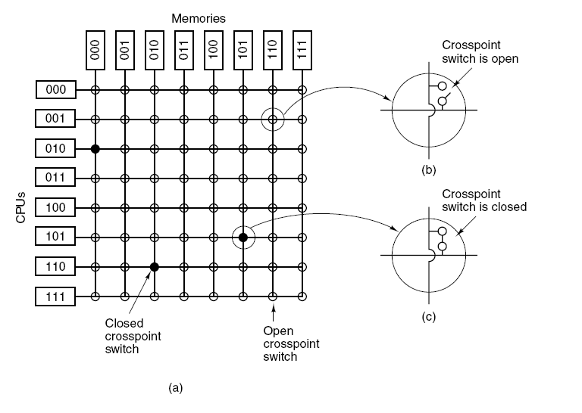
UMA Multiprocessors Using Crossbar Switches
Figure 8-3. (a) An 8 × 8 crossbar switch. (b) An open crosspoint. (c) A closed crosspoint.

Slide 5
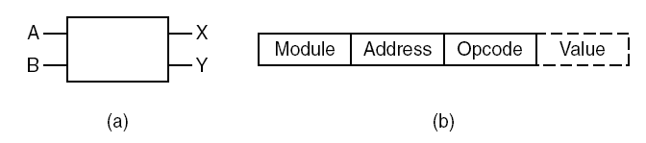
UMA Multiprocessors Using Multistage Switching Networks (1)
Figure 8-4. (a) A 2 × 2 switch with two input lines, A and B, and two output lines, X and Y. (b) A message format.

Slide 6
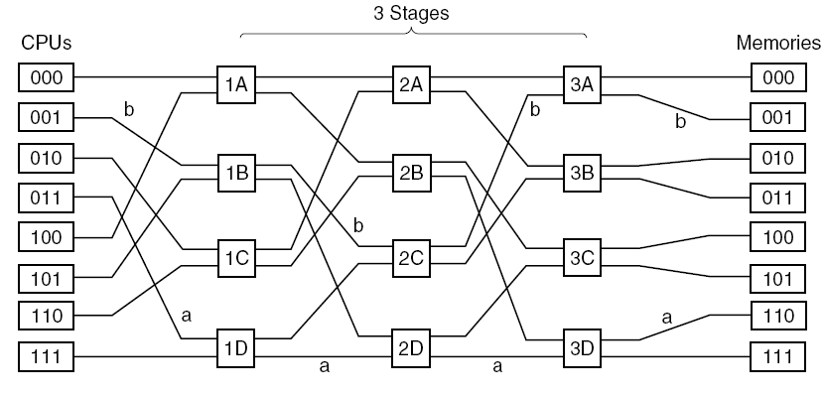
UMA Multiprocessors Using Multistage Switching Networks (2)
Figure 8-5. An omega switching network.

Slide 7
NUMA Multiprocessors (1)
Characteristics of NUMA machines:
There is a single address space visible to all CPUs.
Access to remote memory is via LOAD and STORE instructions.
Access to remote memory is slower than access to local memory.

Slide 8
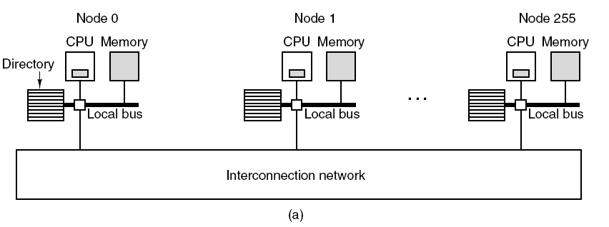
NUMA Multiprocessors (2)
Figure 8-6. (a) A 256-node directory-based multiprocessor.

Slide 9
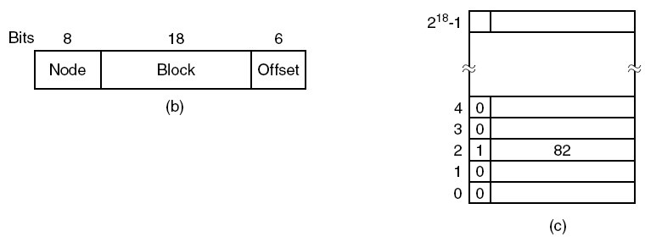
NUMA Multiprocessors (3)
Figure 8-6. (b) Division of a 32-bit memory address into fields. (c) The directory at node 36.

Slide 10
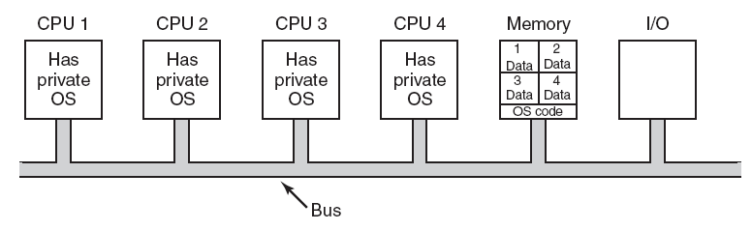
Each CPU Has Its Own Operating System
Figure 8-7. Partitioning multiprocessor memory among four CPUs, but sharing a single copy of the operating system code. The boxes marked Data are the operating
system’s private data for each CPU.

Slide 11
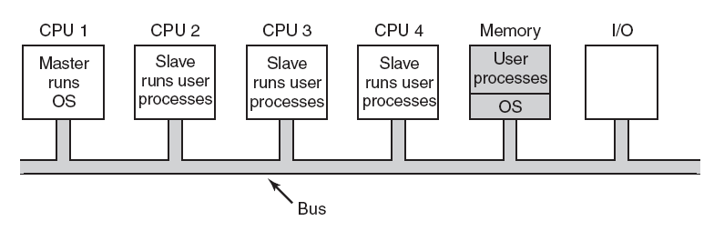
Master-Slave Multiprocessors
Figure 8-8. A master-slave multiprocessor model.

Slide 12
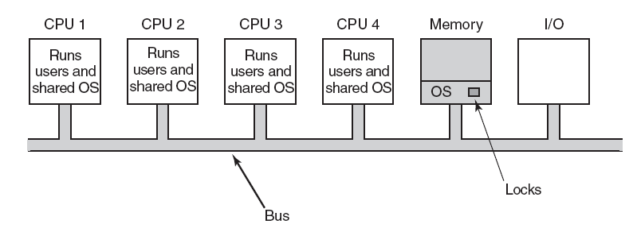
Symmetric Multiprocessors
Figure 8-9. The SMP multiprocessor model.

Slide 13
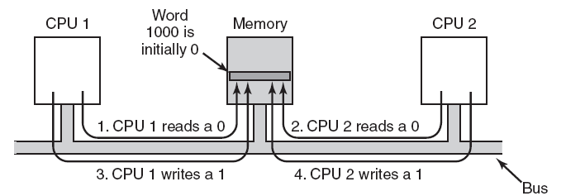
Multiprocessor Synchronization (1)
Figure 8-10. The TSL instruction can fail if the bus cannot be locked. These four steps show a sequence of events where the failure is demonstrated.

Slide 14
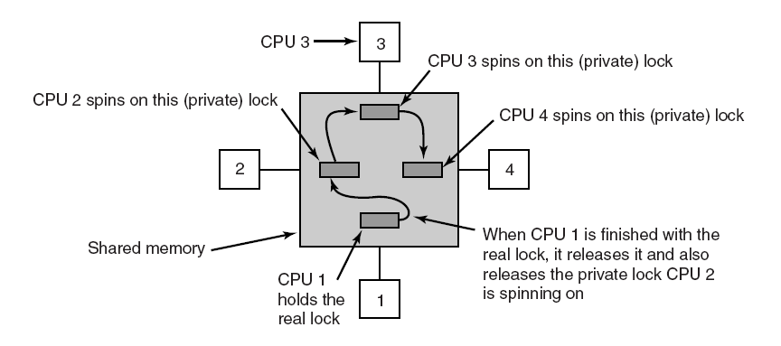
Multiprocessor Synchronization (2)
Figure 8-11. Use of multiple locks to avoid cache thrashing.

Slide 15
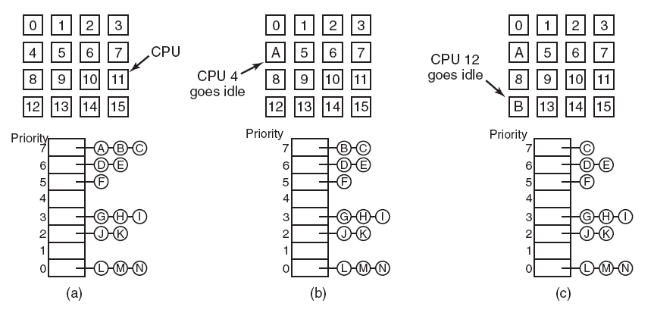
Timesharing
Figure 8-12. Using a single data structure for scheduling a multiprocessor.

Slide 16
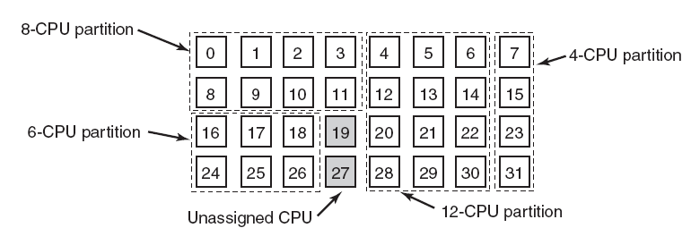
Space Sharing
Figure 8-13. A set of 32 CPUs split into four partitions, with two CPUs available.

Slide 17
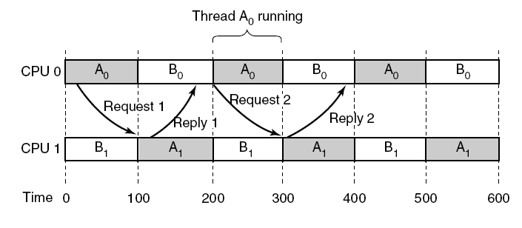
Gang Scheduling (1)
Figure 8-14. Communication between two threads belonging to thread A that are running out of phase.

Slide 18
Gang Scheduling (2)
The three parts of gang scheduling:
Groups of related threads are scheduled as a unit, a gang.
All members of a gang run simultaneously, on different timeshared CPUs.
All gang members start and end their time slices together.

Slide 19
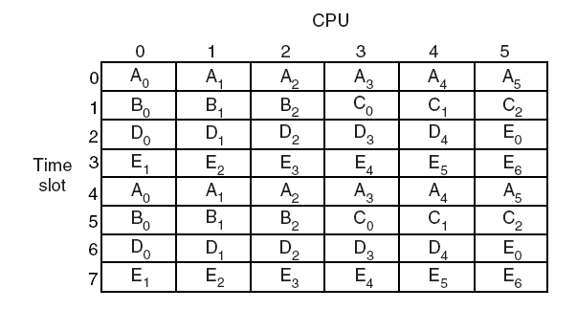
Gang Scheduling (3)
Figure 8-15. Gang scheduling.

Slide 20
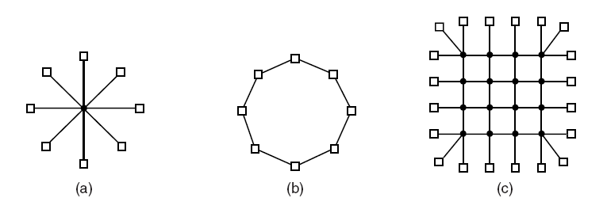
Interconnection Technology (1)
Figure 8-16. Various interconnect topologies. (a) A single switch. (b) A ring. (c) A grid.

Slide 21
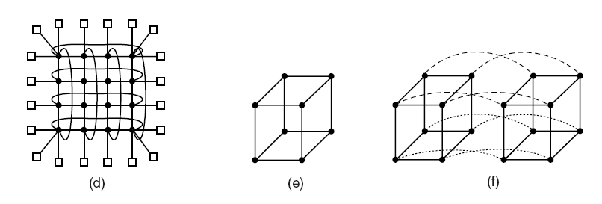
Interconnection Technology (2)
Figure 8-16. Various interconnect topologies. (d) A double torus. (e) A cube. (f) A 4D hypercube.

Slide 22
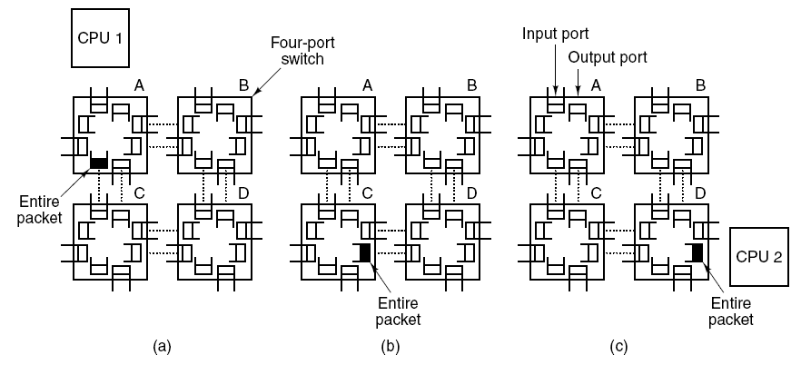
Interconnection Technology (3)
Figure 8-17. Store-and-forward packet switching.

Slide 23
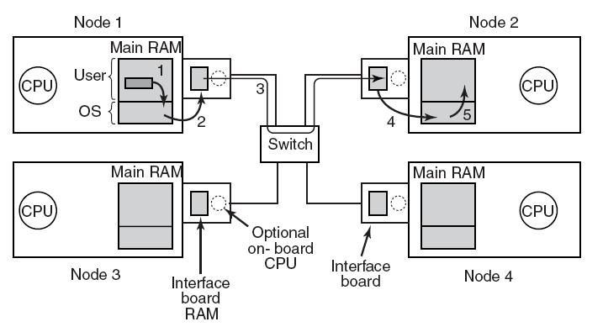
Network Interfaces
Figure 8-18. Position of the network interface boards in a multicomputer.

Slide 24
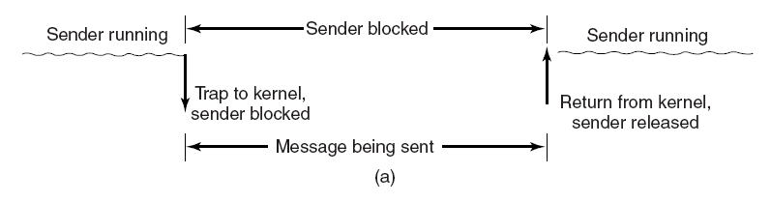
Blocking versus Nonblocking Calls (1)
Figure 8-19. (a) A blocking send call.

Slide 25
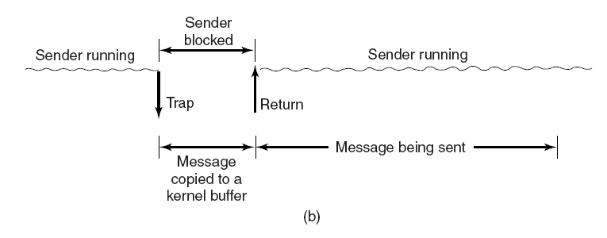
Blocking versus Nonblocking Calls (2)
Figure 8-19. (b) A nonblocking send call.

Slide 26
Blocking versus Nonblocking Calls (3)
Choices on the sending side:
Blocking send (CPU idle during message transmission).
Nonblocking send with copy (CPU time wasted for the extra copy).
Nonblocking send with interrupt (makes programming difficult).
Copy on write (extra copy probably needed eventually).

Slide 27
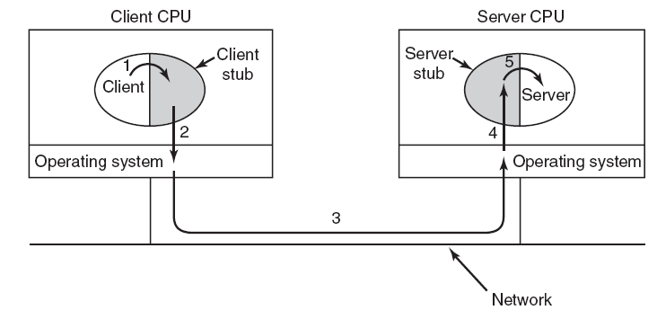
Remote Procedure Call
Figure 8-20. Steps in making a remote procedure call. The stubs are shaded gray.

Slide 28
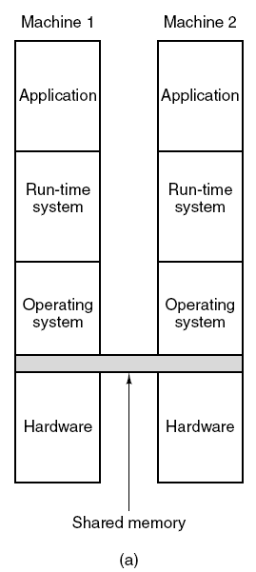
Distributed Shared Memory (1)
Figure 8-21. Various layers where shared memory can be implemented. (a) The hardware.

Slide 29
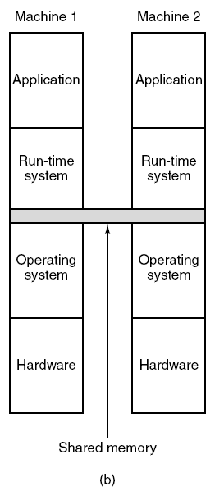
Distributed Shared Memory (2)
Figure 8-21. Various layers where shared memory can be implemented. (b) The operating system.

Slide 30
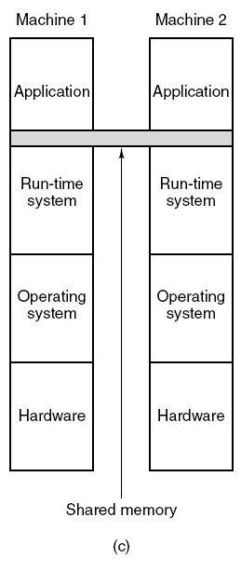
Distributed Shared Memory (3)
Figure 8-21. Various layers where shared memory can be implemented. (c) User-level software.

Slide 31
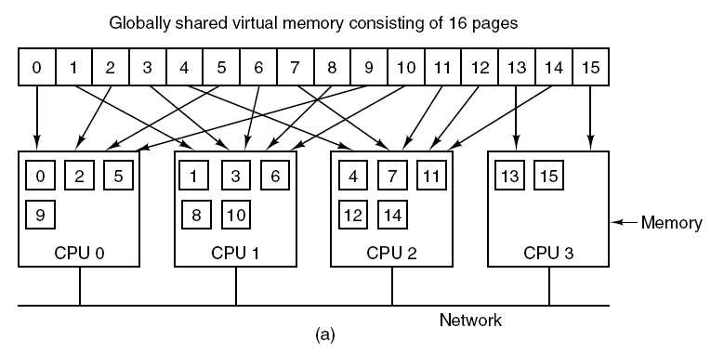
Distributed Shared Memory (4)
Figure 8-22. (a) Pages of the address space distributed among four machines.

Slide 32
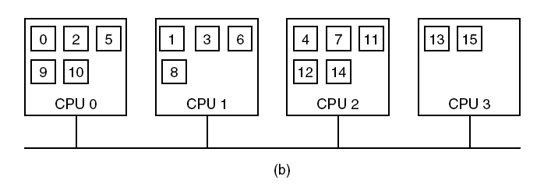
Distributed Shared Memory (5)
Figure 8-22. (b) Situation after CPU 1 references page 10 and the page is moved there.

Slide 33
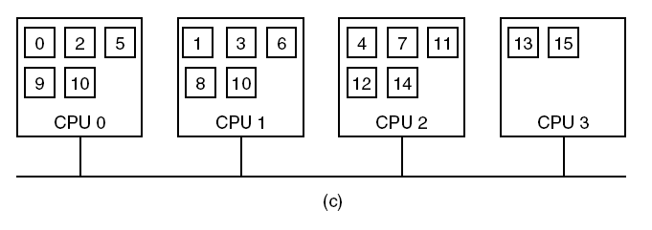
Distributed Shared Memory (6)
Figure 8-22. (c) Situation if page 10 is read only and replication is used.

Slide 34
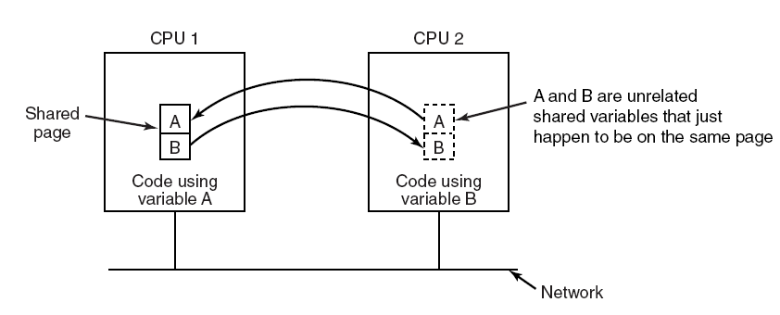
False Sharing
Figure 8-23. False sharing of a page containing two unrelated variables.

Slide 35
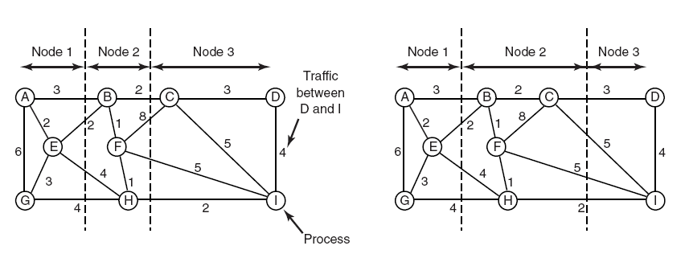
A Graph-Theoretic Deterministic Algorithm
Figure 8-24. Two ways of allocating nine processes to three nodes.

Slide 36
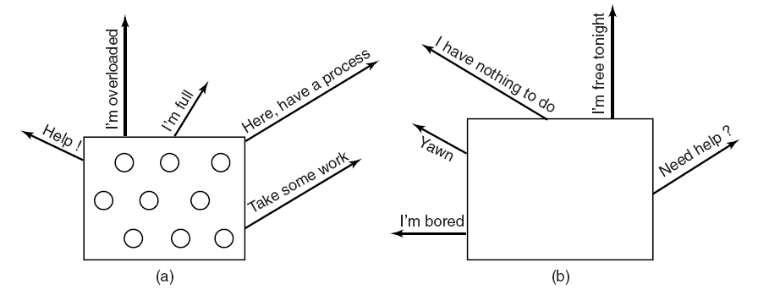
A Sender-Initiated Distributed Heuristic Algorithm
Figure 8-25. (a) An overloaded node looking for a lightly loaded node to hand off processes to. (b) An empty node looking for work to do.

Slide 37
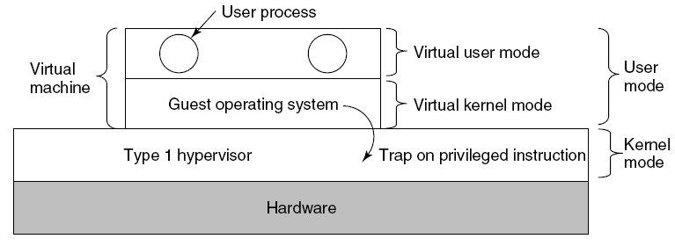
Type 1 Hypervisors
Figure 8-26. When the operating system in a virtual machine executes a kernel-only instruction, it traps to the hypervisor if virtualization technology is present.

Slide 38
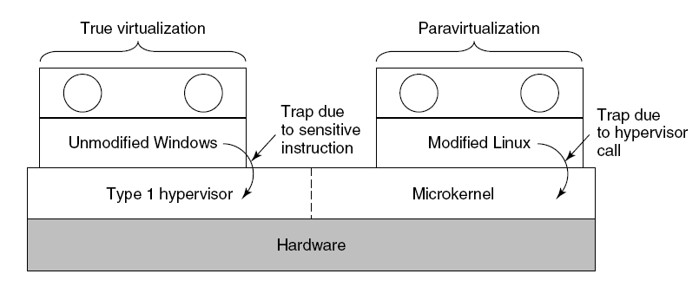
Paravirtualization (1)
Figure 8-27. A hypervisor supporting both true virtualization and paravirtualization.

Slide 39
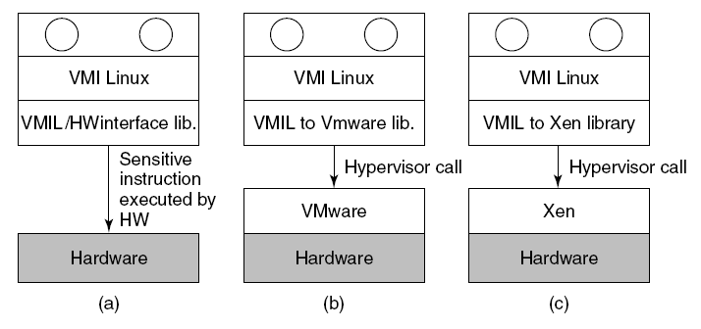
Paravirtualization (2)
Figure 8-28. VMI Linux running on (a) the bare hardware (b) VMware (c) Xen.

Slide 40
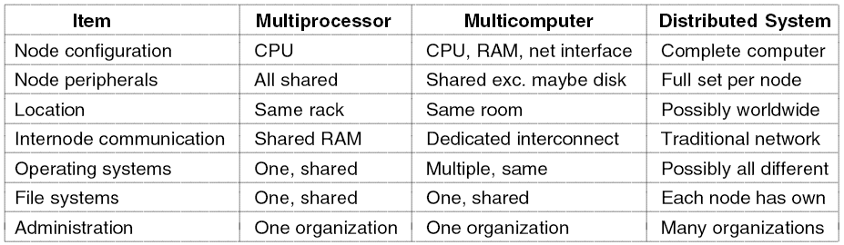
Distributed Systems (1)
Figure 8-29. Comparison of three kinds of multiple CPU systems.

Slide 41
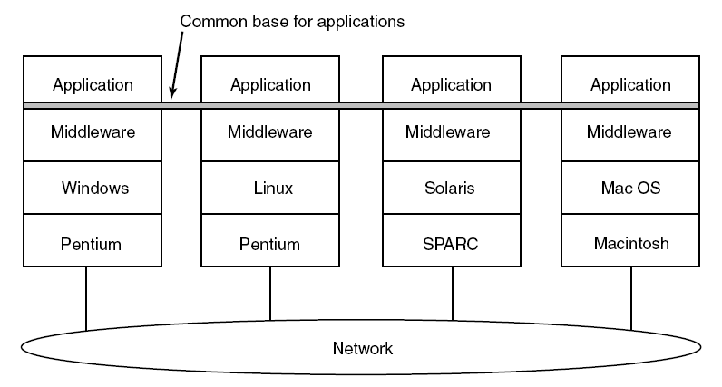
Distributed Systems (2)
Figure 8-30. Positioning of middleware in a distributed system.

Slide 42
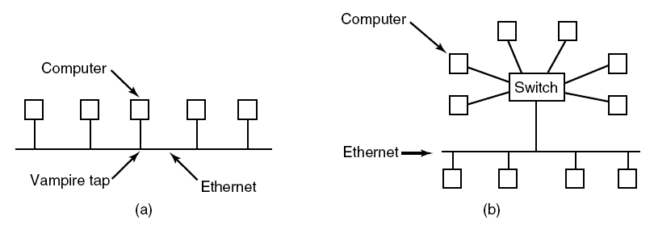
Ethernet
Figure 8-31. (a) Classic Ethernet. (b) Switched Ethernet.

Slide 43
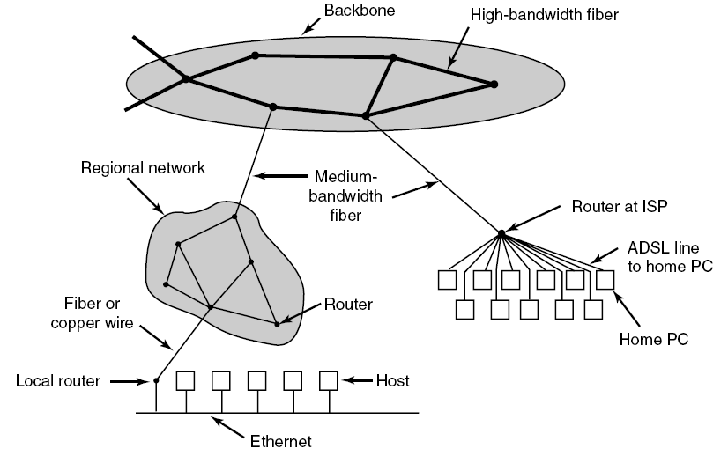
The Internet
Figure 8-32. A portion of the Internet.

Slide 44
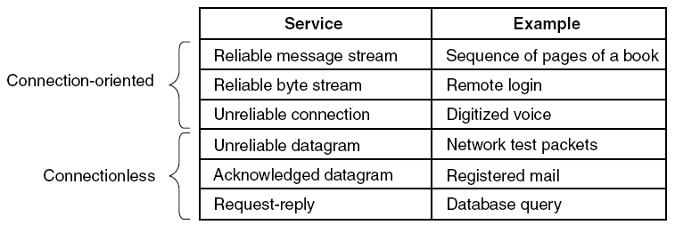
Network Protocols (1)
Figure 8-33. Six different types of network service.

Slide 45
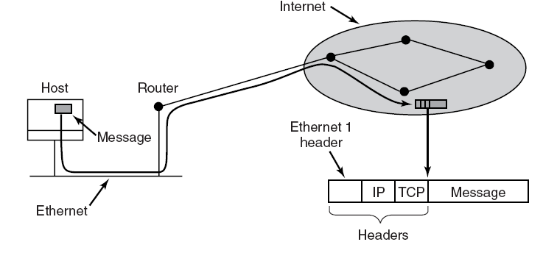
Network Protocols (2)
Figure 8-34. Accumulation of packet headers.

Slide 46
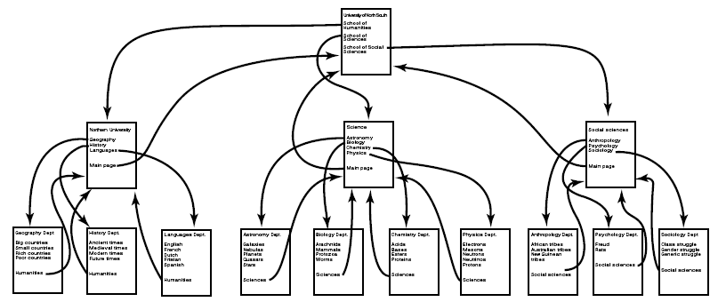
Document-Based Middleware (1)
Figure 8-35. The Web is a big directed graph of documents.

Slide 47
Document-Based Middleware (2)
When the browser gets the page http://www.minix3.org/doc/faq.html.
The browser asks DNS for the IP address of www.minix3.org.
DNS replies with 130.37.20.20.
The browser makes a TCP connection to port 80 on 130.37.20.20.
It then sends a request asking for the file doc/faq.html. . . .

Slide 48
Document-Based Middleware (3)
. . .
The www.acm.org server sends the file doc/faq.html.
The TCP connection is released.
The browser displays all the text in doc/faq.html.
The browser fetches and displays all images in doc/faq.html.

Slide 49
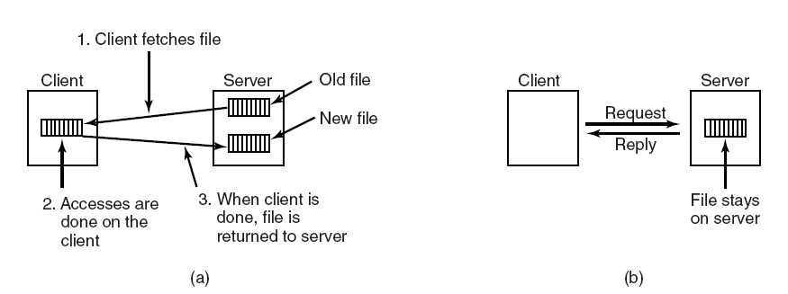
File-System-Based Middleware Transfer Model
Figure 8-36. (a) The upload/download model. (b) The remote access model.

Slide 50
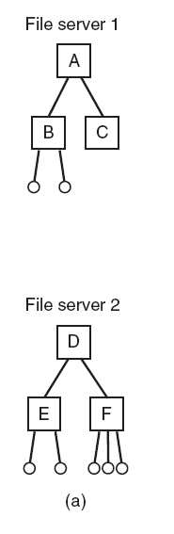
The Directory Hierarchy (1)
Figure 8-37. (a) Two file servers. The squares are directories and the circles are files.

Slide 51
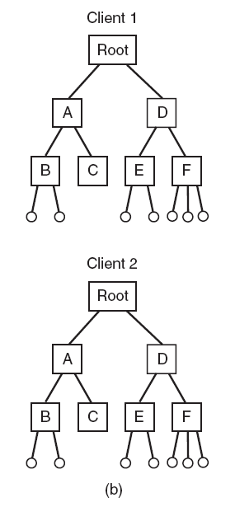
The Directory Hierarchy (2)
Figure 8-37. (b) A system in which all clients have the same view of the file system.

Slide 52
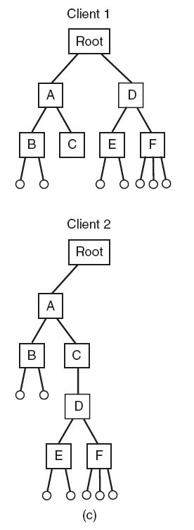
The Directory Hierarchy (3)
Figure 8-37. (c) A system in which different clients may have different views of the file system.

Slide 53
Naming Transparency
Three common approaches to file and directory naming in a distributed system:
Machine + path naming, such as /machine/path or machine:path.
Mounting remote file systems onto the local file hierarchy.
A single name space that looks the same on all machines.

Slide 54
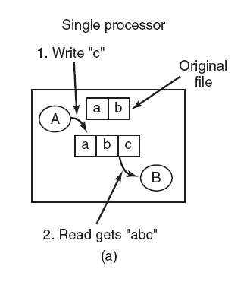
Semantics of File Sharing(1)
Figure 8-38. (a) Sequential consistency.

Slide 55
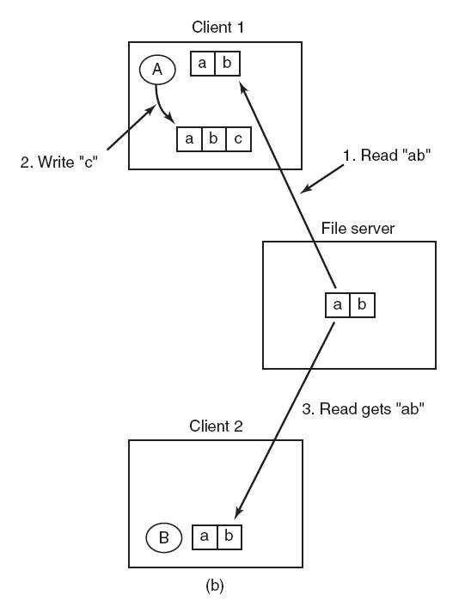
Semantics of File Sharing(2)
Figure 8-38. (b) In a distributed system with caching, reading a file may return an obsolete value.

Slide 56
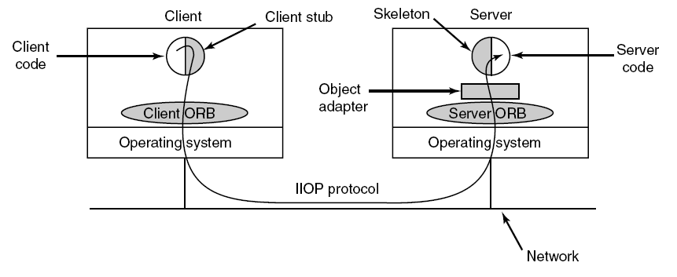
Object-Based Middleware
Figure 8-39. The main elements of a distributed system based on CORBA. The CORBA parts are shown in gray.

Slide 57
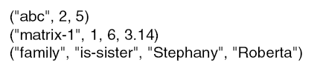
Coordination-Based Middleware (1)
Linda
A system for communication and synchronization
Independent processes communicate via an abstract tuple space
A tuple is a structure of one or more fields, each of which is a value of some type supported by the base language
Figure 8-40. Three Linda tuples.

Slide 58
Matching Tuples
A match occurs if the following three conditions
are all met:
The template and the tuple have the same number of fields.
The types of the corresponding fields are equal.
Each constant or variable in the template matches its tuple field.

Slide 59

Publish/Subscribe
Figure 8-41. The publish/subscribe architecture.

Slide 60
Jini
Jini clients and services communicate and synchronize using JavaSpaces.
Methods defined in a JavaSpace:
Write: put a new entry into the JavaSpace.
Read: copy an entry that matches a template out of the JavaSpace.
Take: copy and remove an entry that matches a template.
Notify: notify the caller when a matching entry is written.

